Slide 1
Brackets in equations
Solving linear equations

Slide 2
how to use Oak lessons

Slide 3
I can appreciate the significance of the bracket in an equation.

Slide 4
An equation is used to show two expressions that are equal to each other.

Slide 5

Brackets in equations
Representations of equations involving brackets
Effectively using brackets in equations

Slide 6
Representations of equations involving brackets
Let’s consider the difference between the following equations:
x × 2 + 4 = 10
(x + 4) × 2 = 10
2x + 4 = 10
2(x + 4) = 10
x
x
4
x
4
x
4
10
10
When you substitute in x = 3,
it works.
When you substitute in x = 1,
it works.

Slide 7


Representations of equations involving brackets
Jun and Jacob are drawing bar models for the equation 4(y + 2) = 20
Jun draws…
Jacob draws…
y
2
y
2
y
2
y
2
y
2
2
2
2
20
20
They are very different. Which do you think is correct?

Slide 8


Representations of equations involving brackets
Jun and Jacob are drawing bar models for the equation 4(y + 2) = 20
Jun draws…
Jacob draws…
y
2
y
2
y
2
y
2
y
2
2
2
2
20
20
Jun correctly drew 4 lots of (y + 2) being equal to 20
Jacob drew y and 4 lots of 2 being equal to 20
y + 2 × 4 = 20

Slide 9
Representations of equations involving brackets
“x multiplied by 2, plus 3 equals 8” will be the same equation as “x plus 3, multiplied by 2 equals 8”
Order matters. This will be two different equations, one of which will need to be written with brackets.
They both have a “multiplied by 2”, and a “plus 3” and make 8 so they are the same equation with the same solution.

Slide 10
Representations of equations involving brackets
Which bar model matches which equation?
x
3
x
3
8
2x + 3 = 8
x + 3 + 3 = 8
x
3
3
8
x + 3 × 2 = 8
2(x + 3) = 8
x + 6 = 8
No bracket, only the 3 doubled.
x
x
3
8

Slide 11
Representations of equations involving brackets
Which bar model matches which equation?
x
1
1
1
3x + 1 = 15
15
x
1
x
1
x
1
3(x + 1) = 15
15
x
x
x
1
x + 1 × 3 = 15
15

Slide 12
Representations of equations involving brackets
Which words match this equation?
3x + 1 = 15
x
x
x
1
15
x multiplied by 3, plus 1 = 15
x plus 3 multiplied by 1 = 15
x plus 1, multiplied by 3 = 15

Slide 13
Representations of equations involving brackets
Which words match this equation?
3(x + 1) = 15
x
1
x
1
x
1
15
x multiplied by 3, plus 1 = 15
x plus 3 multiplied by 1 = 15
x plus 1, multiplied by 3 = 15

Slide 14
Representations of equations involving brackets
For all of these equations with brackets that we have seen, the brackets can be expanded.
2(x + 4) = 10
4(y + 2) = 20
x
4
x
4
y
2
y
2
y
2
y
2
10
20
2 × x + 2 × 4 = 10
4 × y + 4 × 2 = 20
2x + 8 = 10
Expanded form
4y + 8 = 20
Sometimes when solving we will expand the brackets out, sometimes it can be quicker and easier not to.

Slide 15
Representations of equations involving brackets
When we see brackets in an equation we should expand them out.
Because we can expand brackets, when we see them we should always expand them out.
Whilst we can expand brackets if we need to, there will be some moments where it is easier not to.

Slide 16
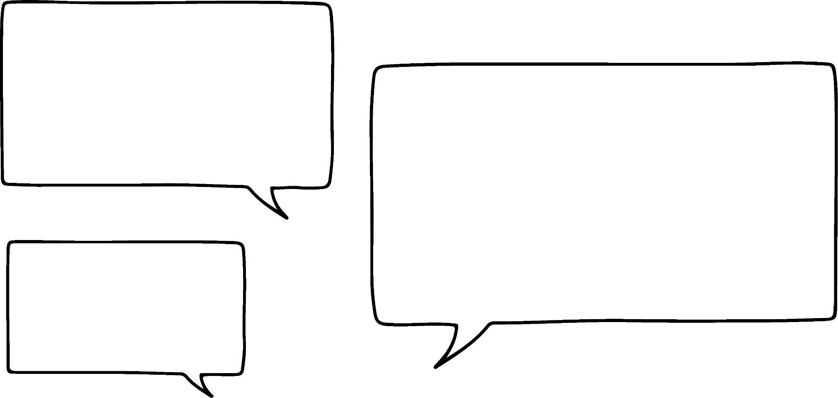


Representations of equations involving brackets
1) Write an equation and draw a bar model for Andeep and Laura’s number problems.
I am thinking of a number. When you multiply it by 5 and add 10 you get 35
I am thinking of a number. When you add 10 and multiply by 5 you get 35
Andeep
Laura

Slide 17
Representations of equations involving brackets
2) Write equations for the bar models that Jun and Jacob have drawn. If you can see more than one way to write the equation you should do so.
y
5
y
5
y
5
y
3
y
3
y
3
y
3
y
3
30
30
Jun
Jacob

Slide 18
Representations of equations involving brackets
1) Write an equation and draw a bar model for Andeep and Laura’s number problems.
I am thinking of a number. When you multiply it by 5 and add 10 you get 35.
I am thinking of a number. When you add 10 and multiply by 5 you get 35.
x × 5 + 10 = 35
(x + 10) × 5 = 35
5x + 10 = 35
Simplified form
5(x + 10) = 35
Andeep
Laura
x
x
x
x
x
10
x
10
x
10
x
10
x
10
x
10
35
35

Slide 19
Representations of equations involving brackets
2) Write equations for the bar models that Jun and Jacob have drawn. If you can see more than one way to write the equation you should do so.
y
5
y
5
y
5
y
3
y
3
y
3
y
3
y
3
30
30
(y + 5) × 3 = 30
(y + 3) × 5 = 30
3(y + 5) = 30
5(y + 3) = 30
Jun
Jacob
3 × y + 3 × 5 = 30
5 × y + 5 × 3 = 30
3y + 15 = 30
5y + 15 = 30

Slide 20
Representations of equations involving brackets
2) Write equations for the bar models that Jun and Jacob have drawn. If you can see more than one way to write the equation you should do so.
y
5
y
5
y
5
y
3
y
3
y
3
y
3
y
3
30
30
3(y + 5) = 30
5(y + 3) = 30
Jun
Jacob
Most commonly you will only see or write these in these simplified forms.
3y + 15 = 30
5y + 15 = 30

Slide 21
Brackets in equations
Representations of equations involving brackets
Effectively using brackets in equations

Slide 22
Effectively using brackets in an equation
It’s important that we multiply every term inside the brackets in order to maintain equality.
8 + 2 = 7 + 3
10 = 10
2 × (8 + 2) = 2 × (7 + 3)
2 × 8 + 2 × 2 = 2 × 7 + 2 × 3
16 + 4 = 14 + 6
20 = 20
We multiplied out correctly. We still have an equation.

Slide 23

Effectively using brackets in an equation
Izzy is expanding a bracket and spots that she has made an error.
4(y + 2) = 20
4y + 2 = 20
Can you point out her error before she corrects it?
She didn’t multiply every term inside the bracket by 4.
4 lots of (y + 2) is…
(y + 2) + (y + 2) + (y + 2) + (y + 2)
= 4 × y + 4 × 2

Slide 24
Effectively using brackets in an equation
Izzy is expanding a bracket and spots that she has made an error.
4(y + 2) = 20
4y + 8 = 20
Can you point out her error before she corrects it?
She didn’t multiply every term inside the bracket by 4
4 lots of (y + 2) is…
(y + 2) + (y + 2) + (y + 2) + (y + 2)
= 4 × y + 4 × 2

Slide 25
Effectively using brackets in an equation
When manipulating equations, which are important?
We multiply both sides of the equation by the same value.
If expanding brackets, we multiply every term inside the bracket.
We draw a visual representation.
We don’t have to, but that can help to support our understanding.

Slide 26
Effectively using brackets in an equation
Izzy is experimenting with multiplying both sides of the equation she is solving.
y + 1 = 3y + 11
10(y + 1) = 10(3y + 11)
1 = 2y + 11
What do you think?
Same solution or different?
−10 = 2y
y = −5
So will I get the same solution if I multiply both sides by 10 or will I get −50 as a solution instead?

Slide 27
Effectively using brackets in an equation
Izzy is experimenting with multiplying both sides of the equation she is solving.
y + 1 = 3y + 11
10(y + 1) = 10(3y + 11)
1 = 2y + 11
10((−5) + 1) = 10(3(−5) + 11)
−10 = 2y
10(−4) = 10(−15 + 11)
y = −5
10(−4) = 10(−4)
−40 = −40
Despite multiplying both sides by 10, we can see that the solution is still −5 by substituting.

Slide 28
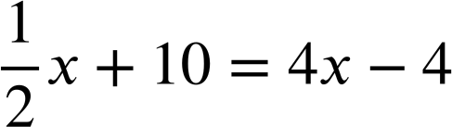
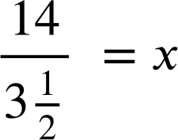
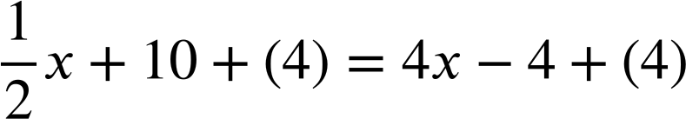
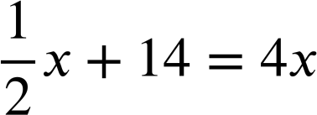
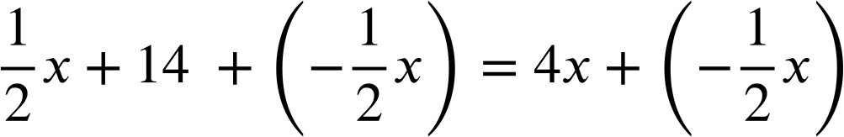
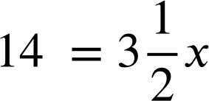
Effectively using brackets in an equation
Why would we want to multiply both sides of an equation?
x = 4
Is there something we could have done to make this more efficient to solve?

Slide 29
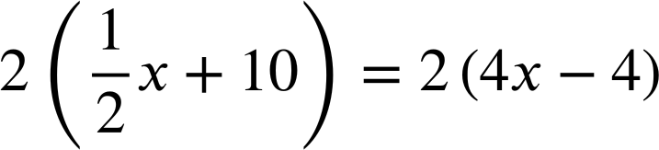
Effectively using brackets in an equation
Why would we want to multiply both sides of an equation?
The multiplicative inverse is ×2
In this form it is simpler to solve.
x + 20 = 8x − 8
28 = 7x
x = 4

Slide 30
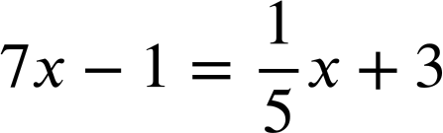
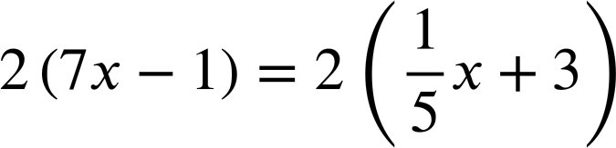
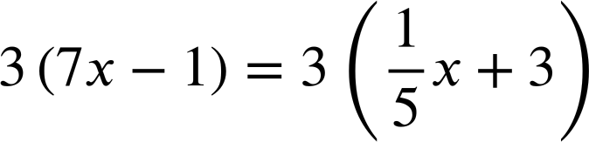
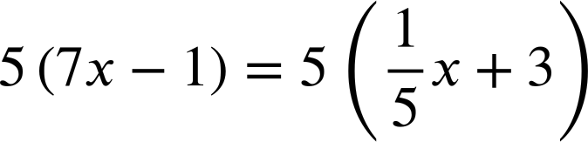
Effectively using brackets in an equation
What might be a useful next step in solving this equation?
×5, the inverse, puts it in a format which is much easier to solve.
35x − 5 = x + 15

Slide 31
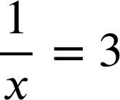
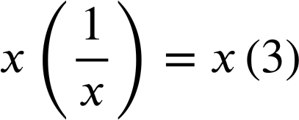
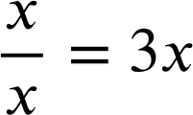
Effectively using brackets in an equation
It is also useful for solving rational equations.
The inverse of ÷ x is × x
In this form it is much more simple to solve.
1 = 3x

Slide 32
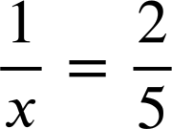
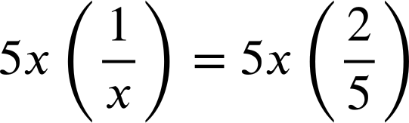
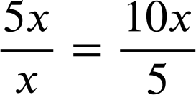
Effectively using brackets in an equation
It is also useful for solving rational equations.
The inverse of ÷ x and ÷ 5 is × 5x
In this form it is much more simple to solve.
1 = 3x
5 = 2x

Slide 33
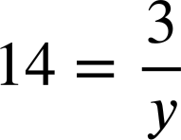
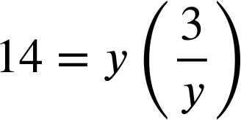

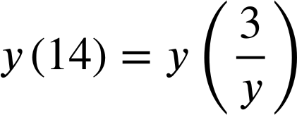
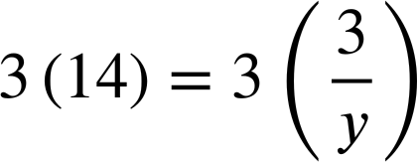
Effectively using brackets in an equation
What might be a useful next step in solving this equation?
× y must be done to both sides.
× y is the inverse of ÷ y and puts it in a format which is much easier to solve.

Slide 34
Effectively using brackets in an equation
1) Spot the errors in these manipulations of equations.
Once spotted, write a sentence to explain each error.
a)
b)
c)
y + 3 = 4y + 6
y + 3 = 4y − 6
y + 3 = 4y + 6
4(y + 3) = 4y + 6
2(y + 3) = 2(4y − 6)
4(y + 3) = 2(4y + 6)
4y + 12 = 4y + 6
2y + 3) = 8y − 6
4y + 12 = 8y + 12

Slide 35
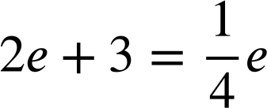
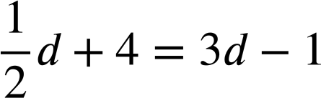
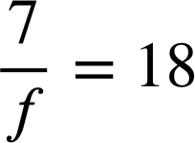
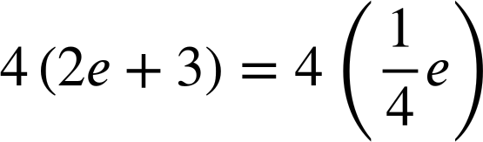
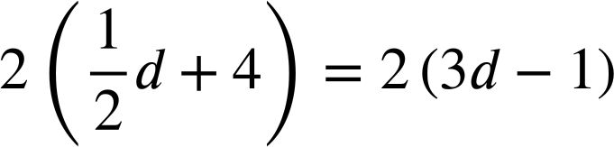
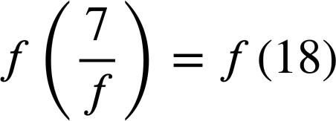
Effectively using brackets in an equation
2) Fill in the missing parts of these manipulations of equations.
a)
b)
c)
8e + 12 = e
d + 8 = 6d − 2
7 = 18f

Slide 36
Effectively using brackets in an equation
1) Spot the errors in these manipulations of equations.
Once spotted, write a sentence to explain each error.
a)
b)
c)
y + 3 = 4y + 6
y + 3 = 4y − 6
y + 3 = 4y + 6
4(y + 3) = 4y + 6
2(y + 3) = 2(4y − 6)
4(y + 3) = 2(4y + 6)
4y + 12 = 4y + 6
2y + 3 = 8y − 6
4y + 12 = 8y + 12
The multiplication only occurred on one side of the equation.
All terms inside the bracket need to be multiplied.
Both sides need to be multiplied by the same term.

Slide 37
Effectively using brackets in an equation
2) Fill in the missing parts of these manipulations of equations.
a)
b)
c)
8e + 12 = e
d + 8 = 6d − 2
7 = 18f

Slide 38
Brackets in equations
Brackets are significant in equations. If manipulated incorrectly they can cause us to lose equality.
If manipulated well they can help us to transform complex looking equations into simple ones.
Example:
8e + 12 = e

Slide 39

© Oak National Academy 2023.
Produced in partnership with Mathematics in Education and Industry.
Licensed on the Open Government Licence v3.0, except where otherwise stated. See Oak terms and conditions.

